Slide 1
Replicator Dynamics

Slide 2
Preliminary
The concept of replicator dynamics is used to express the evolutionary dynamics of an entity called replicator which has means of making more or less accurate copies of itself. The replicator can be a gene, an organism, a strategy in a game, a belief, a technique, a convention, or any institutional or cultural form. In the following, game strategies will be considered.
The concept assumes a large population of replicators, in which different types meet in proportion to their share in the population. This meeting - i.e. the interaction of different replicators (e.g. different strategies in a game) - generates payoffs, which are interpreted as an replicator's fitness. Replicators reproduce with regard to their fitness in relation to the fitness of others. The general idea is that replicators whose fitness is larger (smaller) than the average fitness of the population will increase (decrease) their share in the population.
In evolutionary game theory replicators are strategies, which compete for dominance according to the payoff they yield in interaction. Typical examples are the strategies of cooperation and defection in games like the Prisoners Delemma or the Public Good Game. Similar to dominant strategies bringing forth Nash equilibria when games are repeated, strategies in replicator dynamics can become evolutionary stable.
An Evolutionarily Stable Strategy (ESS) is a strategy which, if adopted by a population in a given environment, cannot be invaded by any alternative strategy that is initially rare.
Maynard Smith, J.; Price, G.R. (1973). The logic of animal conflict. Nature. 246 (5427): 15–8.
Maynard Smith, J. (1972). Game Theory and The Evolution of Fighting. On Evolution. Edinburgh University Press.
Mathematically, replicator dynamics are expressed in the form of so called replicator equations, which is a set of differential equations used to study dynamics in evolutionary game theory. The replicator dynamics provide a simple model of evolution and success-driven (or prestige-biased) learning in games.

Slide 3
Preliminary
Evolutionary process : Mutation vs Natural selection
Mutation : 진화의 끊임없는 변화의 가능성을 가늠
Natural selection : 진화가 어느 방향으로 일어나는지 결정
Stability of the mutation : ESS (Evolutionary Stable Strategy)
-> 시스템의 안정성 여부 검증 (Mutant 출현에 의해 시스템이 붕괴 or 견뎌냄)
Stability of the NS : Replicator Dynamics
-> Mutant에 의해 파괴된 환경, 혹은 불균형인 상황에서
어떠한 식으로 균형의 조정이 이루어지고 어느 균형을 향해 시스템이 움직이게 될 지 예측

Slide 4

Replicator Equation

Slide 5
Replicator Equation
Current frequency
of strategy
Own fitness relative to the average
“More successful strategies grow faster”

Slide 6
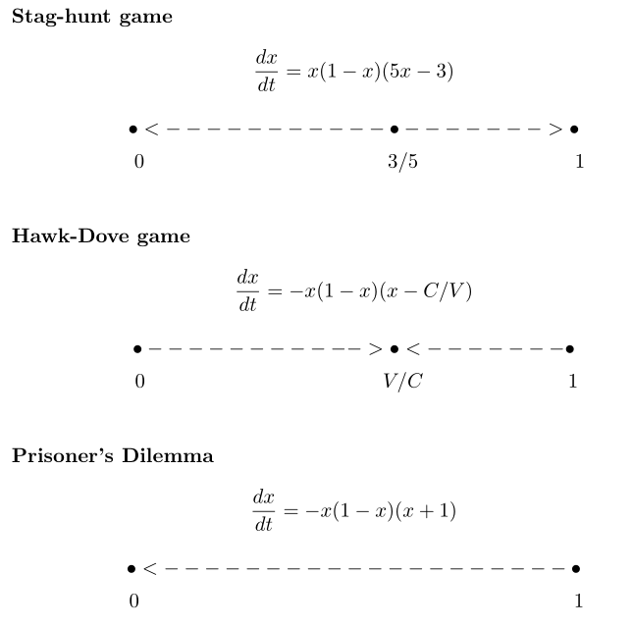
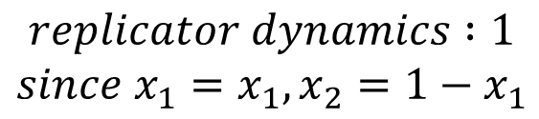
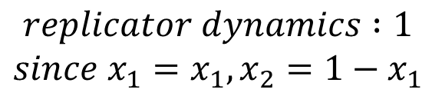
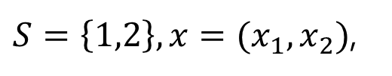
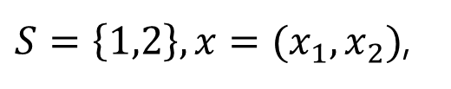
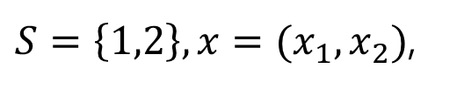
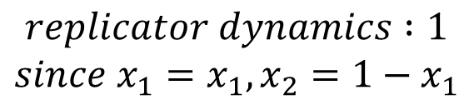
The strategy set $S=\left\{1,2,⋯,K\right\}$ and the frequency in the population $x=(x_{1}, ⋯x_{K})$,
Not asymptotically Stable.
$S=\left\{1,2\right\}, x=(x_{1}, x_{2})$,
$$replicator dynamics :1$$
$$since x_{1}=x_{1}, x_{2}=1−x_{1}$$
Asymptotically Stable.
$S=\left\{1,2\right\}, x=(x_{1}, x_{2})$,
$$replicator dynamics :1$$
$$since x_{1}=x_{1}, x_{2}=1−x_{1}$$
Globally Stable.
$S=\left\{1,2\right\}, x=(x_{1}, x_{2})$,
$$replicator dynamics :1$$
$$since x_{1}=x_{1}, x_{2}=1−x_{1}$$

Slide 7
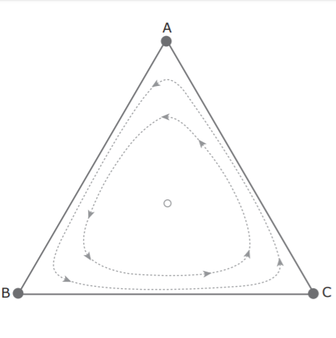

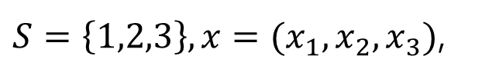








$S=\left\{1,2,3\right\}, x=(x_{1}, x_{2},x_{3})$,
$$x_{P}=1$$
Not asymptotically Stable.
$$replicator dynamics :3$$
$\left(x_{R}, x_{P}\right)=(0.5,0.5)$
$\left(x_{S}, x_{P}\right)=(0.5,0.5)$
 | R | P | S
R | 0 | -1 | 1
P | 1 | 0 | -1
S | -1 | 1 | 0
$\left(x_{R}, x_{P},x_{S}\right)=(0.33,0.33,0.33)$
Starting frequencies:
$x=(0.25,0.25,0.5)$
$$x_{R}=1$$
$\left(x_{R}, x_{S}\right)=(0.5,0.5)$
$$x_{S}=1$$

